Slide 1
Deploying applications in kubernetes
Copyright 2018 Zack Moore @ormico
https://github/ormico

Slide 2
Slides and Examples
You can find the slides and examples here.
https://github.com/ormico/kubernetes-2018Presentation
They may be updated a few days after the presentation with the latest changes.

Slide 3
Background – Docker, Containers, and Orchestrators
Short Answers
Containers are like “Lite” VMs except they don’t have their own OS kernel and instead use a shared kernel (like Linux Docker Containers on Windows) or the Host OS’s kernel.
Docker is the leading implementation of Containers across Linux and Windows.
Orchestrators help manage utilizing containers, usually across multiple hosts, and handle a lot of the grunt work like networking, load balancing, fault tolerance, and configuration.

Slide 4
What is Kubernetes (k8)
From http://kubernetes.io
“Kubernetes is an open-source system for automating deployment, scaling, and management of containerized applications.”
Abbreviated as K8
Is an “Orchestrator” Like Docker Swarm
Is built on top of Docker

Slide 5
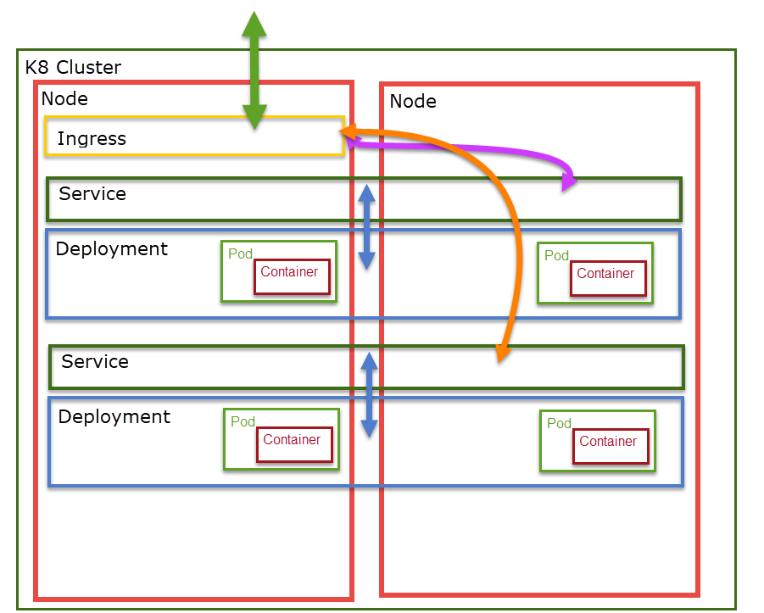
K8 Structure
A K8 Cluster is a collation of Nodes working together.
A Node is a physical or virtual machine in a K8 Cluster for running containers.
An Ingress is a container for bridging communication inside and outside the cluster. Ingresses communicate with Services.
A Service provides a single internal IP address and Domain name for communicating with a Deployment using a Round Robin or other load balancing scheme.

Slide 6
Pods and Containers
Pods usually contain a single container.
In certain special cases, pods can contain multiple containers but when this is the case all containers within a pod always run on the same node.

Slide 7
Deployments and PODS
For most applications, pods are published to k8 as deployments.
A deployment describes
What container image(s)
How many starting pods
Mounted Volumes
Secrets
Other types of Pod and Container configuraiton

Slide 8
Services and Deployments
K8 maintains an internal private network using a non-publicly routable IP range.
Similar to how your home router uses a private ip range and NATs everything in and out over a single IP address.
Services provide a single internal IP address for communicating with a deployment using a load balancing algorithm; usually, round-robin.
Services can be setup with alternate settings such as
Exposing to public network as a port on each Node
Exposing to public network using cloud provider Load Balancer

Slide 9
DNS
Every service has a unique internal domain name based on it’s namespace and service name.
Each service domain name is suffixed with svc.cluster.local
For example, a service named www in namespace default would have a domain name of: www.default.svc.cluster.local
Containers within the same namespace only need to specify the service name in DNS queries.
For example, a background processing container in namespace default would only need to specify www as a DNS query to find the www service also in the default namespace.

Slide 10
Ingress and Service
The typical way to expose a Service/Deployment to the public network or Internet is through an Ingress.
An ingress is a pod that can communicate with the internal and external networks and route traffic between them. A typical use case is a reverse-proxy web server serving traffic from we server containers to the Internet.
A common reverse proxy web server to use in this role is nginx (pronounced Engine-X)
https://www.nginx.com/
https://docs.microsoft.com/en-us/azure/aks/ingress-tls

Slide 11
Ingress and SSL/TLS
Can perform SSL/TLS off-loading. Install the SSL certificate on the ingress and server over port 80 from web containers.
Can cause some issues if web application thinks it is not under HTTPS. May require using some like the following from ASP.NET Core:
app.UseForwardedHeaders(new ForwardedHeadersOptions
{
ForwardedHeaders = ForwardedHeaders.XForwardedHost | ForwardedHeaders.XForwardedProto
});
This tells ASP.NET Core to be aware of and use the XForwardedHost and XForwardedProto headers.
http://bit.ly/2Nc5dWW

Slide 12
Jobs and scheduled jobs
Allow you to schedule a container and guarantee it will run to completion.

Slide 13
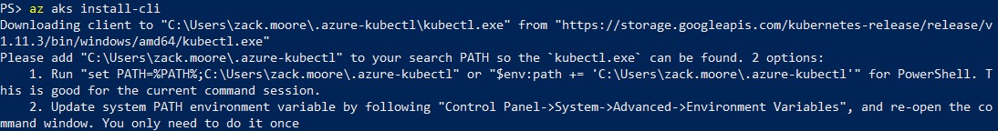
Kubectl : Kubernetes cli
Cross Platform
Download and add to your PATH
https://kubernetes.io/docs/tasks/tools/install-kubectl/
If you have the Azure CLI 2, you can install it this way:

Slide 14
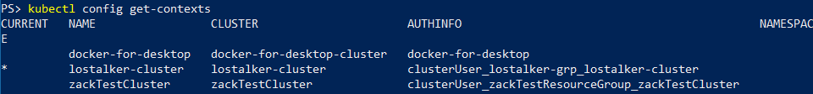
kubectl Context
Kubectl can remember the different clusters that you connect to. Each remembered connection is referred to as a Context.
To list the contexts you currently have:

Slide 15
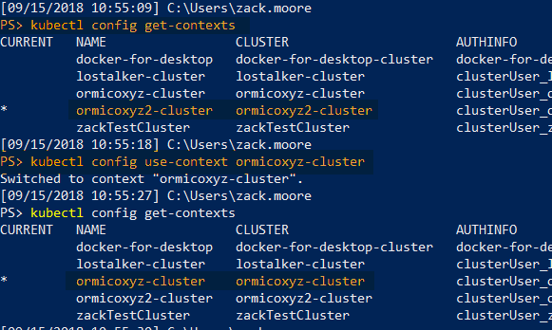
Kubectl switching context
Use kubectl use-context to switch to the cluster you want to use

Slide 16
Getting Kubernetes
Local Development
Docker for Windows
MiniKube – I could never get MiniKube to work
Cloud
Azure
AKS https://azure.microsoft.com/en-us/services/kubernetes-service/
Amazon AWS
Amazon Elastic Container Service for Kubernetes https://aws.amazon.com/eks
Google Cloud
Google Container Engine https://cloud.google.com/kubernetes-engine/
Install yourself

Slide 17
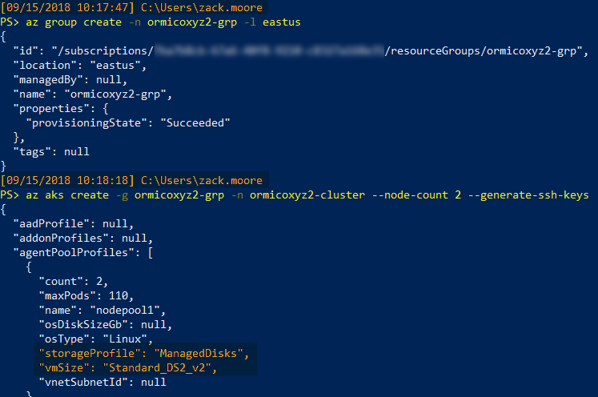
Azure : create Cluster
Download and install latest Azure CLI 2 (not Powershell)
https://docs.microsoft.com/en-us/cli/azure/install-azure-cli?view=azure-cli-latest
Don’t forget to login
PS> az login
Create a cluster with:
PS> az aks create
Took about a minute.
Note Default VM Size

Slide 18
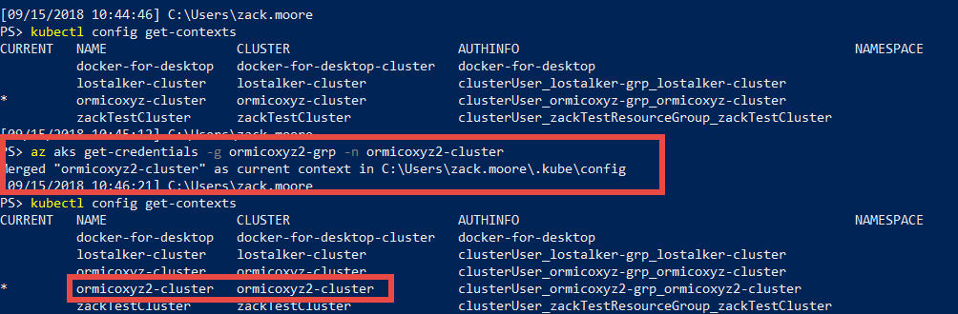
Azure : Connect to Cluster
Use CLI to download credentials into kubectl and switch contexts

Slide 19
application
Web application running on ASP.NET Core
Azure SQL Server (not in k8)
RabbitMq
Nginx Ingress proxy for Web Application

Slide 20
yaml
I’m not a fan of, but most of the examples use YAML.
It is indent based instead of delimiter based.
You an use JSON instead.

Slide 21
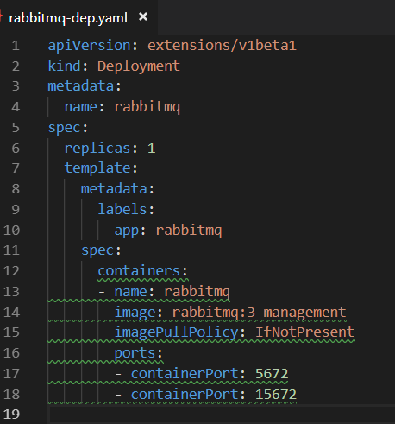
Rabbit Deployment yaml
Name our deployment
Set starting replica count. Since I’m not creating a rabbit cluster, I set it to one.
Set image and tell k8 to pull it if it doesn’t already have it.
Specify which ports to open.

Slide 22
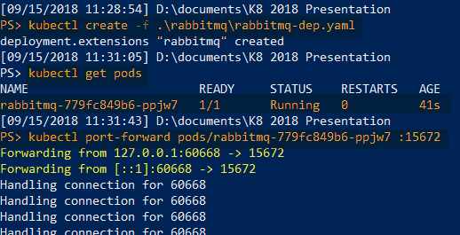
Deploy Deployment
Deploy the rabbit deployment.
Check to see if the pod(s) got created and are not erroring.
If there was a problem you might see the pod restart count going up or see it stuck in a starting state.
Forward the port from the rabbitmq management console so we can test it locally.

Slide 23
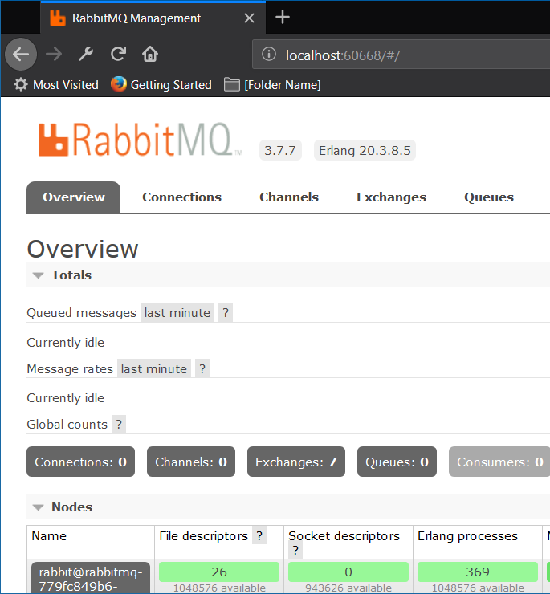
Check Rabbit Management Dashboard
Open web browser to localhost and port returned from port-forward command.
Log into rabbitmq using default credentials guest/guest since we didn’t set a new password.

Slide 24
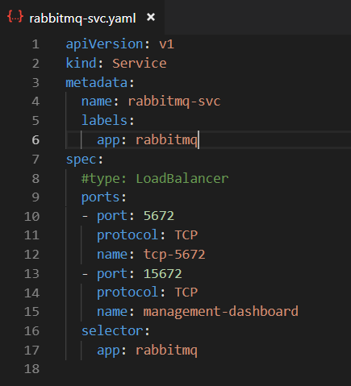
Rabbit k8 Service YAML
Specifies kind as Service
Notice different apiVersion. Different “kinds” are supported by different apiVersions so you have to specify the one you need when you are creating a new object.
Set ports to open. Should match ports from Deployment.
Set the Deployment to target using selector/app.
Type of Service defaults to LoadBalancer (RoundRobin)

Slide 25
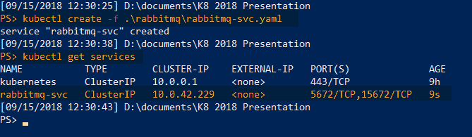
Create Rabbit k8 Service
Create Service using kubectl and rabbitmq-svc.yaml
List services to see that it was created correctly.

Slide 26
Secrets
Kubernetes supports the concept of Secrets.
A Secret is configuration information that you want to protect.
Secrets are mounted into a container as a Volume.

Slide 27
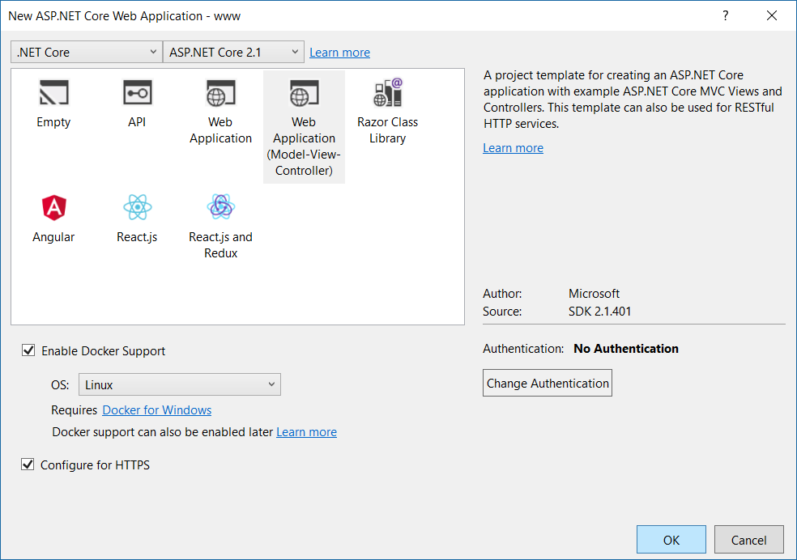
Create Test website
I won’t go into how you get your website into a docker container. There are plenty of other resources for that.
We start by creating an ASP.NET Core MVC application.

Slide 28
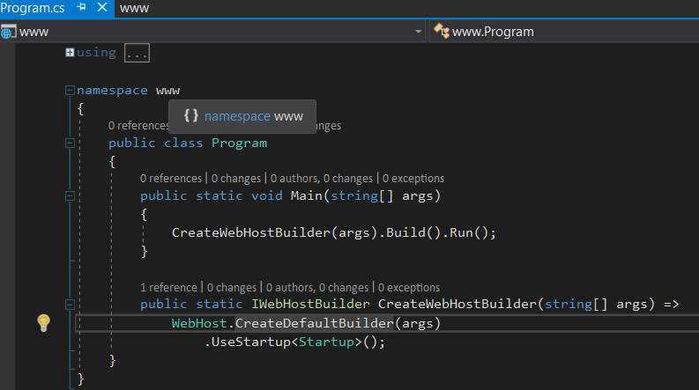
Checking for Prod Config
Open Program.cs and take a look at CreatWebHostBuilder()

Slide 29
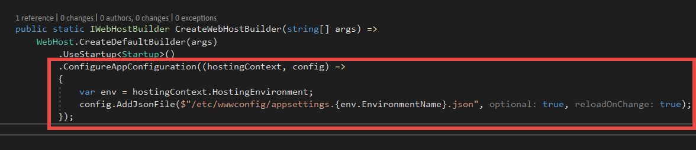
Checking for Prod Config
Add a section to optionally read in an additional appsettings JSON config file.
The path we are using is where we will tell k8 to mount the secrets volume.

Slide 30
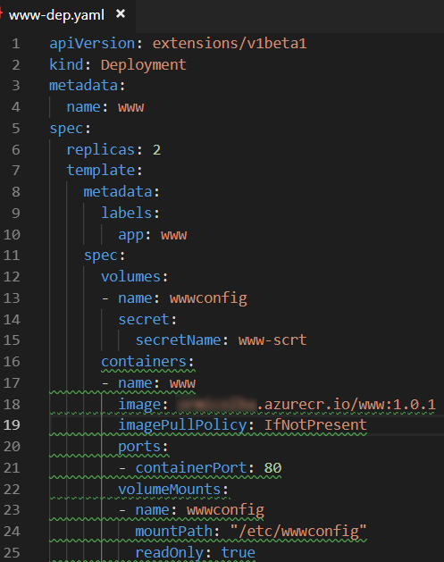
www deployment yaml
Similar to Rabbit Deployment YAML
Setting replicas to two.
Pulling image from our own registry.
Mounting secret file in wwwconfig volume.
Exposing port 80

Slide 31
Helm

Slide 32
Logs

Slide 34
Self-heal

Slide 35
Auto-scale?

